Slide 1

VIP Website 8.0/Mobile Judge 10
Team Members: David Venta and
Sergio Hernandez Padron Product Owner: Francisco Ortega and Masoud Sadjadi
Instructor: Masoud Sadjadi School of Computing and Information Sciences Florida International University
VIP/Senior Project Final Presentation
Spring 2018
Notes:
7 seconds.( I will select 2 best slides (i will give them extra points and students will present for CIS committee)
Greet your audience, thank them for attending your presentation, introduce yourself, introduce your project, introduce your team members, and quickly indicate what each of you did in a high-level manner, and put more emphasis on your part/contribution.

Slide 2
Project definition
Whole Project:
Automated data transfer
Improved UI and access to information
Improved Mobile Judge registration process
Added course functionality
My Part
David:
PantherSoft file’s data is populated from the server into VIP website automatically.
Implement setting parameters that restrict students to an specific date range for selecting projects.
Make frequently visited pages mobile compatible.
Sergio:
Implemented new login/registration flow for judges using a three token system.
Implemented course selection algorithm for the assignment of questions to judges depending on student course.
Implemented a data summary and consistency check tool that analyses and displays this data in a dashboard.
Notes:
10 seconds.
Introduce the problem that the whole project (in all versions) tackles with GIF or screenshot.

Slide 3
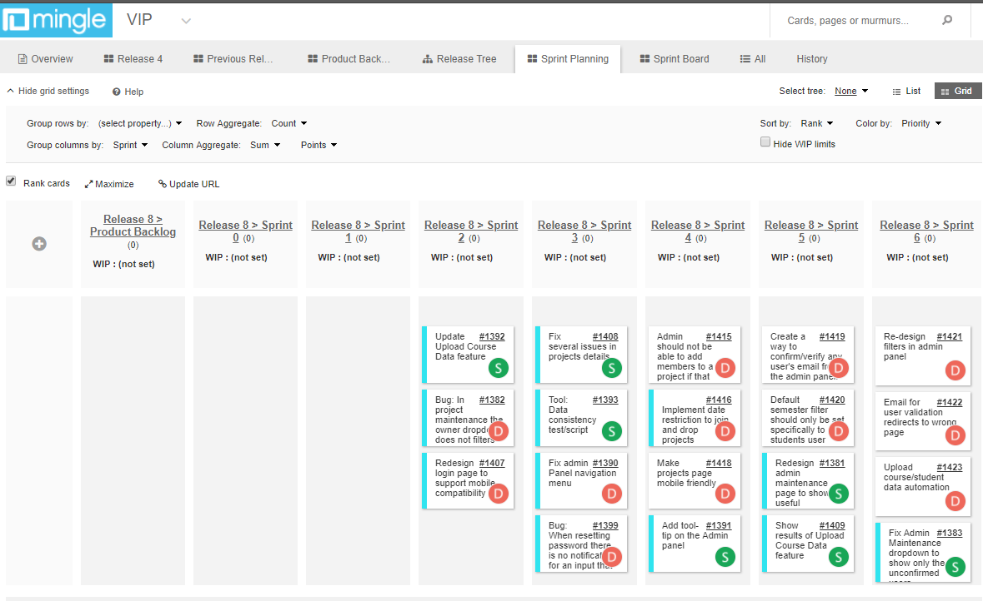
Project Management
Notes:
20 seconds.
Introduce the problem that the your project (in new version) tackles with GIF or screenshot.

Slide 4
Key User Stories
Upload course/student data automation.
2. Implement date restriction to join and drop projects.
3. Make frequently visited pages mobile compatible.
4. Data consistency check tool/summary.
5. Re-structure the flow of login/registration of judges into the system
6. Implement course based questions
Notes:
5 seconds.
List the user stories that you worked on them.(put in order of importance). Stay focused on the parts that you have been working.

Slide 5
Upload course/student data automation.
Description:
As an admin, I would like to have all the data from courses and students populated automatically from the server, so that I am able to sync the students into the courses without having to do it manually.
Acceptance Criteria:
Read “panthersoft” files from root directory and populate onto “upload course” feature screen.
Populate course list with the files of the format reg-ABC-1234.txt or reg-ABC-1234-INC.txt (incomplete students from previous semesters).
User will be imported to the system with the first letter capitalized.
Users with space in their last name shall be imported to the VIP website.
Users with a last name with less than 4 characters shall be imported to the VIP website.
Warning messages shall be displayed for files with wrong data format. Details about file name and row number shall be displayed to user for reference.
Notes:
60 seconds
The tile of user story
The most important user story you worked on it. You have to describe this one very well and be proud of that.
Please present and show the complexity of your work, code, algorithms, and technical challenges and technologies you have used. (you could use screenshot if you want. Visual presentations are better than text presentation)
Go into the details of the most important/significant tasks using bullet lists or visual graphs or state chart diagram
Sequence Diagram for this user story is mandatory (in another separate page if required)
Demo using screenshots or GIF (in another separate page if required)

Slide 6
Implement date restriction to join and drop projects.
Description:
As an Admin, I would like to restrict the joining and dropping of students in projects based on a range of dates
Acceptance Criteria:
Provide an input form for setting start and end date
Restrict joining a project outside deadline range.
Restrict dropping a project outside deadline range.
Notes:
20 seconds
The tile of user story
Please present and show the complexity of your work, code, algorithms, and technical challenges and technologies you have used. (you could use screenshot if you want. Visual presentations are better than text presentation) - Go into the details of the most important/significant tasks using bullet lists or visual graphs or state chart diagram - Demo using screenshots or GIF (in another separate page if required)
Sequence Diagram for this user story is optional

Slide 7
Make frequently visited pages mobile compatible.
Description:
As any user type, I would like to see a mobile friendly project and login page, so that when I am using a mobile device, I am able to see all the useful information about the projects and login page.
Acceptance Criteria:
Max capacity and currently enrolled number of members on the project should be shown when using a mobile device.
Project names and logo should shrink when user scales the page or uses a mobile device..
A small sized video should be shown in case user wants to see the video for that specific project.
White space should be used with useful information
Videos should scale to appropriate place when using the mobile size of the web page
Notes:
20 seconds
The tile of user story
Please present and show the complexity of your work, code, algorithms, and technical challenges and technologies you have used. (you could use screenshot if you want. Visual presentations are better than text presentation) - Go into the details of the most important/significant tasks using bullet lists or visual graphs or state chart diagram - Demo using screenshots or GIF (in another separate page if required)
Sequence Diagram for this user story is optional

Slide 8
Data consistency check tool/summary.
Description:
As developer I would like to implement a data consistency test/script that we can run to detect inconsistencies in the database, this will greatly improve the debugging and testing process. The data is not always entered consistently because there are several ways to create/update users, projects and courses. This script should be easy to update with new consistency rules.
Acceptance Criteria:
Check for mandatory fields that are empty on all tables
Users that are students should all be enrolled in a course, project, semester that exist
A course should have at least one student, if not deleted
A project should always have an owner, owner email, existing semester.
This could eventually be added to the Admin Maintenance section to show all discrepancies found.
Notes:
20 seconds
The tile of user story
Please present and show the complexity of your work, code, algorithms, and technical challenges and technologies you have used. (you could use screenshot if you want. Visual presentations are better than text presentation) - Go into the details of the most important/significant tasks using bullet lists or visual graphs or state chart diagram - Demo using screenshots or GIF (in another separate page if required)
Sequence Diagram for this user story is optional

Slide 9
Restructure the flow of login/registration of judges into the system
Description:
As Admin, I would like to restructure the flow of login/registration of judges into the system, so that judges can login/register into the system easier and without too much admin or helpdesk intervention.
Acceptance Criteria:
Case 1 - First Token
1.1-For imported judges (st: PR )
1.2-Send Initial invite (st: IN) with options of (Accept, Decline, Remove)(st: PE, RJ, RE)
1.3-Judge shows up at event he/she access the app and is asked for email and token1 (request token from helpdesk)
1.4-An email is sent to verify him/her and once they click on the link if it is within the event time frame send him to update profile if desires, assign him students and send him/her to judges home page to start grading (st:RG).
1.5-If they click on the link again and they are st:RG, AT, ST, GR then system will just send them back to the home page with its student to continue grading, if is not any of the previous st then send to update profile assign students and then home page.
Notes:
20 seconds
The tile of user story
Please present and show the complexity of your work, code, algorithms, and technical challenges and technologies you have used. (you could use screenshot if you want. Visual presentations are better than text presentation) - Go into the details of the most important/significant tasks using bullet lists or visual graphs or state chart diagram - Demo using screenshots or GIF (in another separate page if required)
Sequence Diagram for this user story is optional

Slide 10
Restructure the flow of login/registration of judges into the system
Acceptance Criteria:
Case 2 - Second token
2.1-For judges that are not imported but they have been in the system or judges that forget the email they used initialy
2.2-Judge shows up at event he/she access the app and is asked for email and token2 (request token from helpdesk)
2.3-An email is sent to verify him/her and once they click on the link if it is within the event time frame send him to update profile if desires, assign him students and send him/her to judges home page to start grading (st:RG).
2.4-If they click on the link again and they are st:RG, AT, ST, GR then system will just send them back to the home page with its student to continue grading, if is not any of the previous st then send to update profile assign students and then home page.
Case 3 - Third token
3.1-For judges that walk-in and are invited at the event
3.2-Judge shows up at event he/she access the app and is asked for email and token3 (request token from helpdesk)
3.3-No email is sent to verify him/her. If it is within the event time frame send him to update profile if desires, assign him students and send him/her to judges home page to start grading (st:RG).
Register screen: remove password and social links, change button name to save, and remove top message
Notes:
20 seconds
The tile of user story
Please present and show the complexity of your work, code, algorithms, and technical challenges and technologies you have used. (you could use screenshot if you want. Visual presentations are better than text presentation) - Go into the details of the most important/significant tasks using bullet lists or visual graphs or state chart diagram - Demo using screenshots or GIF (in another separate page if required)
Sequence Diagram for this user story is optional

Slide 11
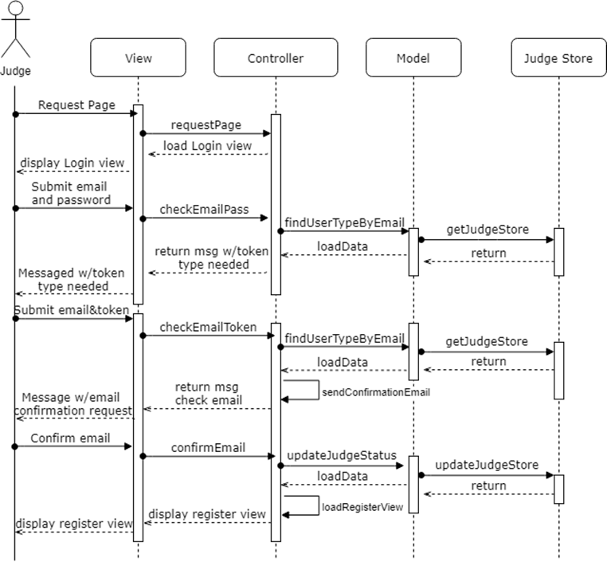
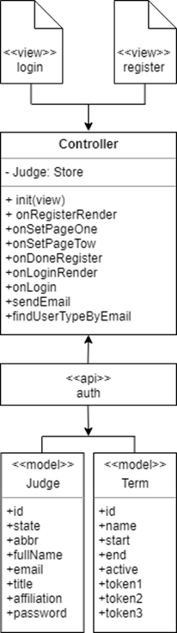
Diagrams: Restructure the flow of login/registration of judges into the system
Notes:
5 seconds
Show the Use Case Diagram for the whole project. Highlight your use cases.

Slide 12
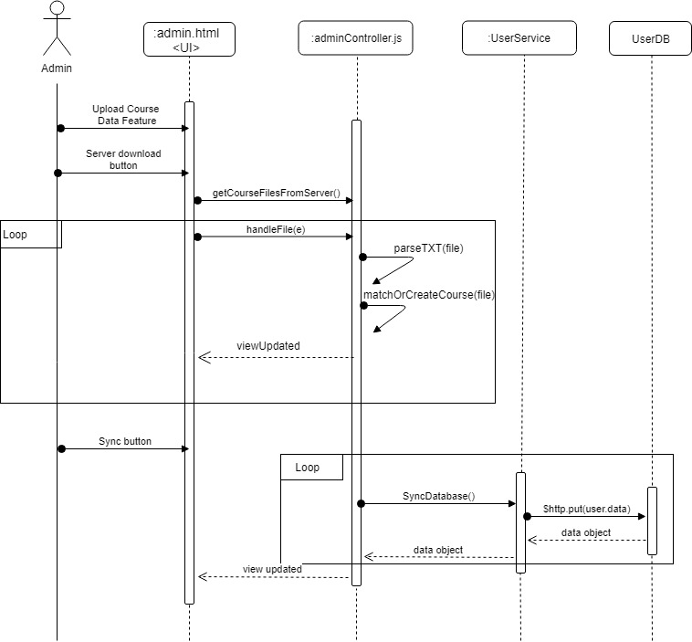
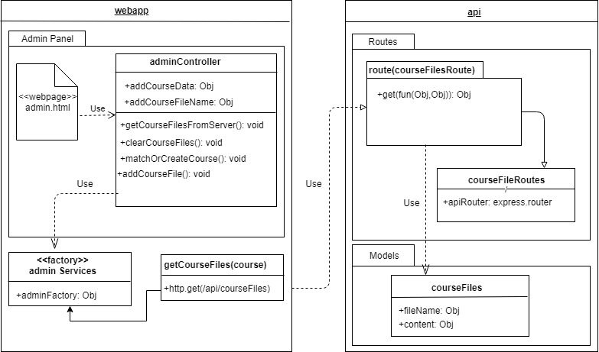
Requirements: Diagrams
Upload course/student data automation.
Notes:
5 seconds
Show the Use Case Diagram for the whole project. Highlight your use cases.

Slide 13
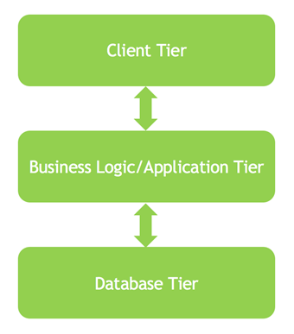
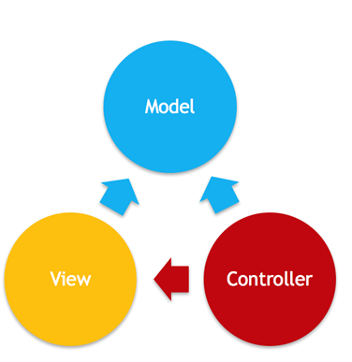
System Design: Architecture
3-tiered architecture
Model-View-Controller
Notes:
20 seconds
System design: Highlight the parts that you contributed to them.
1. System decomposition; identify the architecture patterns used
2. System deployment – h/w and s/w requirements

Slide 14
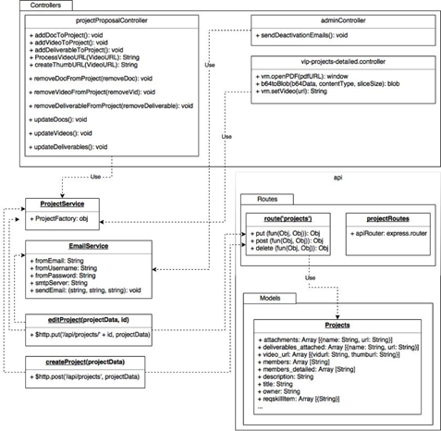
Minimal Class Diagram
Notes:
10 seconds.Minimal class diagram. Highlight the classes that you created/modified
Identify the design patterns used (one or more slides).

Slide 15
Test Suites and Test Cases
Test case ID: 724-01
Summary of Test: A potential judge tries to login and a message refers him to the helpdesk to request an specific type of token depending on his/her email. If it is a type 1 or 2, a confirmation email is sent. Once the email is confirmed registration starts, and then students are assigned. Type 3 does not need email confirmation.
Pre-condition: A Judge has status pending and in the login screen.
Expected Results: An email is sent and after confirming, the registration process starts, students are assigned to judge and judge is redirected to the grading screen.
Status of test (Fail/Pass): Pass
Notes:
10 seconds
A description of verification process and Test Suites and Test Cases for one of the use cases.
1 One sunny day and one rainy day for the implemented use cases (one or more slides).
2 Automated test scripts for the implemented use cases (if any) (one or more slides).

Slide 16
Test Suites and Test Cases
Test case ID: VIP-1423-U1
Summary of Test: Admin tries to up download files to be synced to VIP website. He/she clicks on “download from server” button. Then, all files are populated from the server to the “Upload Course Data” feature. Finally, admin syncs the data and receives all the statistics of the data being imported to the system.
Pre-condition:
Admin has to be logged in to the system
Admin needs to be at the course maintenance tab
Admi must click on “Upload Course Data” button
Expected Results: All files are populated from server and upload screen shows all the statistics
Status of test (Fail/Pass): Pass
Notes:
10 seconds
A description of verification process and Test Suites and Test Cases for one of the use cases.
1 One sunny day and one rainy day for the implemented use cases (one or more slides).
2 Automated test scripts for the implemented use cases (if any) (one or more slides).

Slide 17



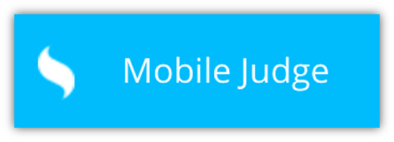





Summary
Improved time efficiency and effort to import user’s data from the server.
Users are restricted to a time frame established by the Admin to join/drop projects.
Most frequently visited pages are now mobile friendly.
Improved functionality and smoothness of Mobile Judge usage by adding a more flexible registration process.
Improved functionality of Mobile Judge by adding course distinction to judge’s questions about student’s presentation.
Increased data consistency of VIP Website by creating important data checking tool and dashboard.
Questions?
Thank You!
Contact information:
David Venta - dvent014@fiu.edu
Sergio Hernandez Padron - shern187@fiu.edu
Notes:
10 seconds
Summarize your contribution, mention your effort for Scrum, Mingle, Github, Google Drive Documentation and minutes
Include your contact information
Ask if anyone has any questions for you.
Thank your audience

